Slide 1

Hooked or High Seas: Neural Networks for Fishing Status Classification
By 2d Lt Nico De Ros

Slide 2



My Topic
Originally, I was working with YOLOv8
Simply too much to learn, I am not that bright
Then I wanted to do a bug classifier
Bed bug or Not Beg bug, similar to Cat or Not Cat
Unfortunately, too expensive!
Settled on Fishing Boat data
Good data found, related to thesis, and most importantly: Free!

Slide 3

Notes:
This slide shows why I did not proceed with a bug classifying ANN

Slide 4
My Topic
Originally, I was working with YOLOv8
Simply too much to learn, I am not that bright
Then I wanted to do a bug classifier
Bed bug or Not Beg bug, similar to Cat or Not Cat
Unfortunately, too expensive!
Settled on Fishing Boat data
Good data found, related to thesis, and most importantly: Free!

Slide 5
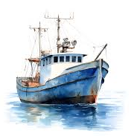
The Data
Provided by Global Fishing Watch
14.7 million observations, each with 9 features and 1 response
mmsi: the unique, 13-digit MMSI of a ship,
timestamp: UNIX timestamp of the observations’ recording,
distance_from_shore: Distance from shore in meters,
distance_from_port: Distance from port in meters,
speed: Vessel speed in knots,
course: Vessel course in degrees,
lat: Latitude in decimal degrees,
lon: Longitude in decimal degrees, and
source: Data was prepared by GFW, Dalhousie, and a crowd sourcing campaign.
is_fishing: numerically encoded response can either be a -1, 0, 1, or value between 0 and 1.

Slide 6
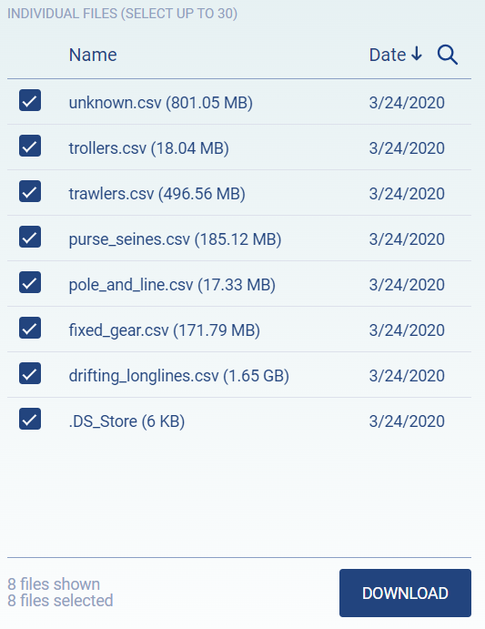
Preprocessing
Data came in individual csv files
First step was to individually download each file and combine into a single, combined csv file

Slide 7

Preprocessing
Remove responses with no data
is_fishing == -1
Change floats to be a 1
Fix rows with 0 entries
Course, Speed, Distance from *
Fix rows with missing values
None!
Fix rows with extreme or unlikely entries
Distance from *, longitude, latitude, and course

Slide 8
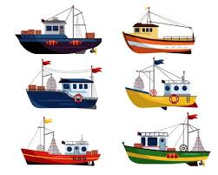
Data Splitting
Desired a 65/17.5/17.5 data split
Maximized the size of the training set while being uploadable to GitHub
Split data by MMSI
Many ships were observed more than once (some, hundreds of times!)
Final data split: 65/17/18 training/validation/testing sets

Slide 9
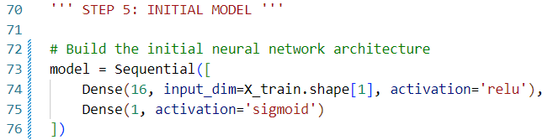
Initial Model
Measure of Success for all models will be accuracy
Feedforward Neural Network, 5 epochs with a batch size of 32
One hidden layer with 16 neurons, ReLU activation function
Binary output (Fishing or Not Fishing)
Compiles and runs. That’s all!

Slide 10
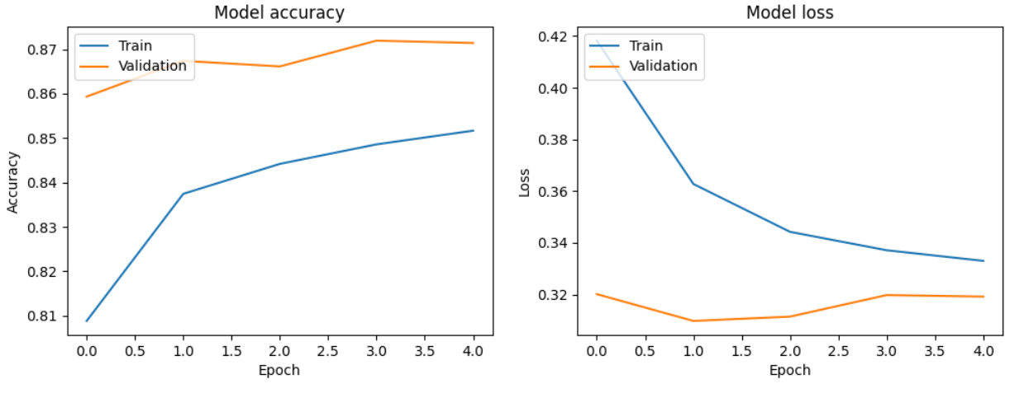
Initial Model Accuracy and Loss Plots
Test Accuracy: 85.64%
Test Loss: 35.12%

Slide 11
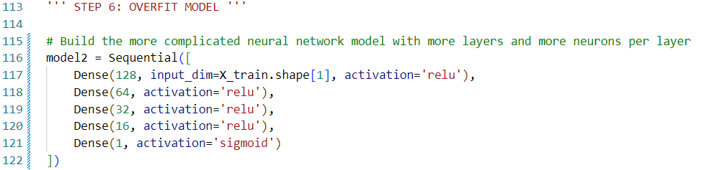
Overfit Model
Improves upon initial model by increasing number of layers, neurons per layer, and number of epochs run
Feedforward Neural Network, 20 epochs with a batch size of 32
4 Hidden Layers:
128, 64, 32, and 16 neurons in sequence. Each has a ReLU activation function.
Binary output

Slide 12
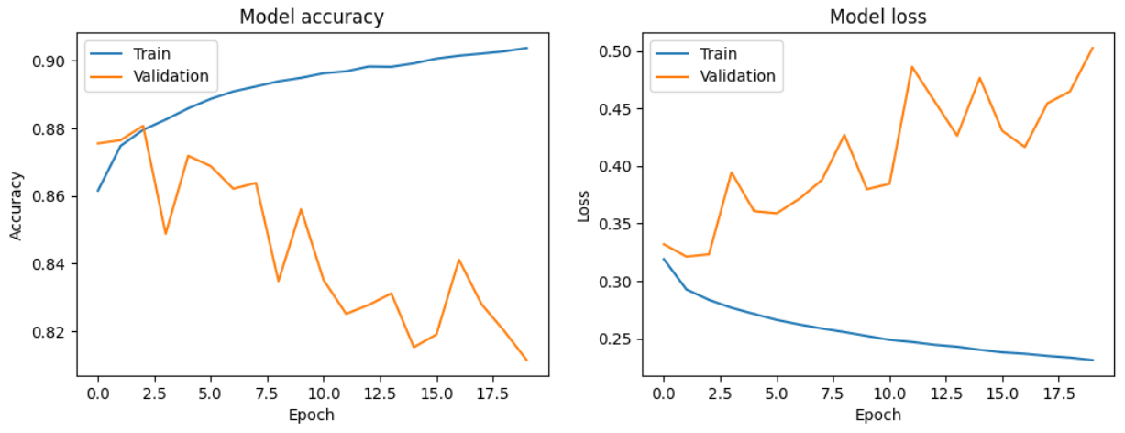
Overfit Model Accuracy and Loss Plots
Test Accuracy: 82.50%
Test Loss: 48.17%

Slide 13
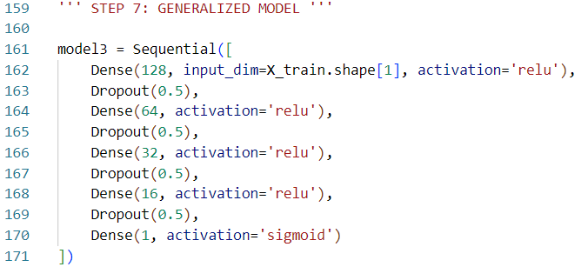
Generalized Model
Improves upon overfit model by adding dropout and early stopping
Experimented with L1 and L2 regularization, dropout worked better
Feedforward Neural Network, 200 epochs with a batch size of 32
4 Hidden Layers with dropout implemented in each
Dropout Rate is 0.5

Slide 14
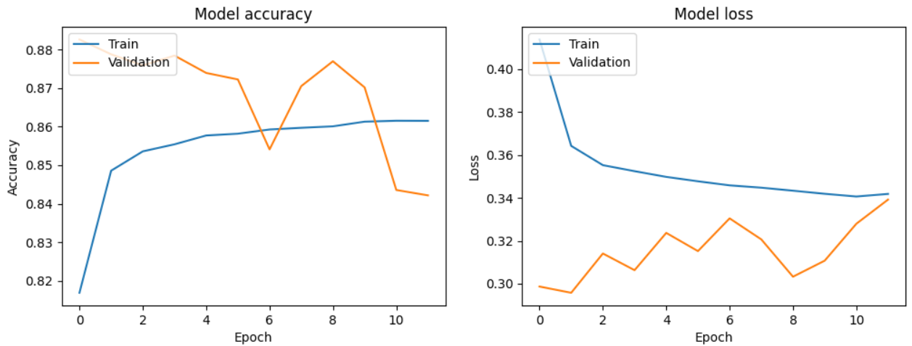
Generalized Model Accuracy and Loss Plots
Test Accuracy: 84.22%
Test Loss: 34.11%

Slide 15
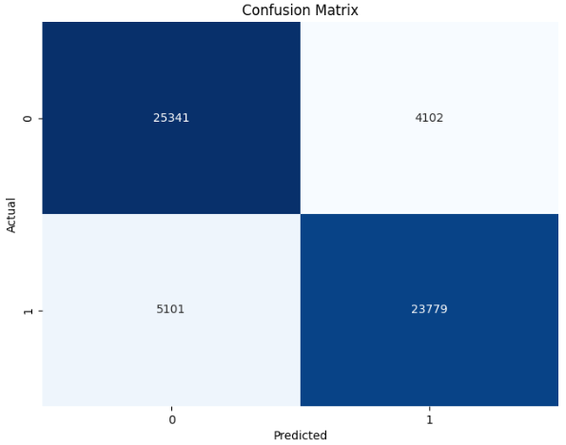
Generalized Model Confusion Matrix
Accuracy: 84.22%
Precision: 85.29%
Recall: 82.34%

Slide 16
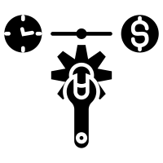
Hyperparameter Tuned Model
Improves upon generalized model by adding hyperparameter tuning
Tried to implement grid search for numerical values
Ended up with a high and low level for each factor
Feedforward Neural Network, 200 epochs with a batch size of 32
4 Hidden Layers with dropout implemented in each
Early stopping included

Slide 17
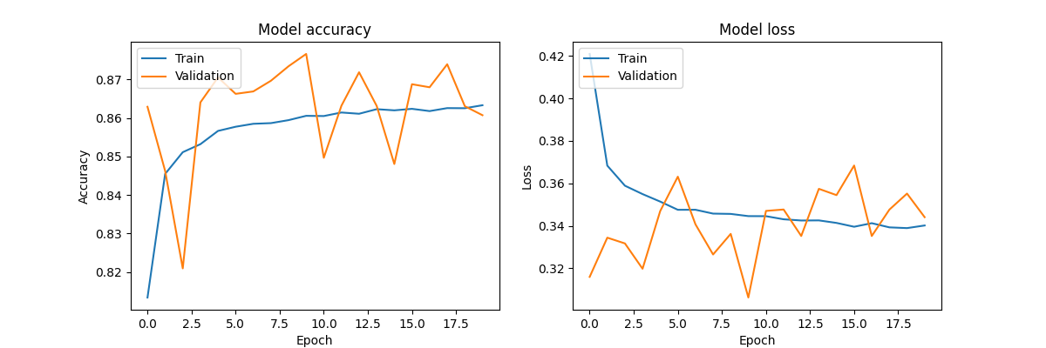
HP Tuned Model Accuracy and Loss Plots
Test Accuracy: 86.19%
Test Loss: 34.14%

Slide 18
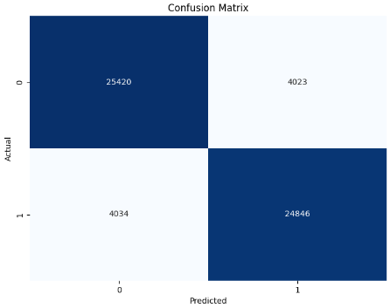
HP Tuned Model Confusion Matrix
Accuracy: 86.19%
Precision: 86.06%
Recall: 86.03%

Slide 19

Results
Metric | Generalized | HP Tuned
Accuracy | 84.22% | 86.19%
Precision | 85.29% | 86.06%
Recall | 82.34% | 86.03%
HP Tuned model had 2% higher accuracy
Also had 1% higher precision and 4% higher recall
Best hyperparameters were:
Optimizer: Adam,
Dropout Rate: 0.5,
Neurons in Layer 1: 64,
Neurons in Layer 2: 32,
Neurons in Layer 3: 32, and
Neurons in Layer 4: 16

Slide 20
Conclusion
Hyperparameter Tuning can provide a useful way to improve a model by searching the HP space to find optimal values to set each HP to
This method is powerful, but slow
Training a single model with 20 epochs took 15 minutes
Doing HP tuning with two levels for 6 variables took 10 hours
Recommendations:
Only fully explore the HP space for applications that can have consequences to human health and safety, otherwise save time and do a light search!

Slide 21

Questions

Slide 22
Questions (and Applause)

